Slide 1

HTML and CSS
Course Overview
SoftUni Team
Technical Trainers
Software University
https://softuni.bg

Slide 2
Table of Contents
Introduction
Training and Team
Course Objectives
Course Organization

Slide 3
Have a Question?
sli.do
#html-css

Slide 4











SoftUni Diamond Partners

Slide 5



Educational Partners

Slide 6

HTML and CSS
Course Objectives & Program

Slide 7

HTML and CSS – Course Topics
Introduction to HTML and CSS
HTML Structure
3. CSS & Typography
4. CSS Box Model
5. Position & Float
6. Flexbox

Slide 8
HTML and CSS – Course Topics
8. Media Queries
9. Design to Code – Demo Project
10. Exam Preparation

Slide 9
HTML and CSS Course – Timeline
19-May-2021
4-July-2021
24-August-2021
HTML and CSS
Lessons + exercises + exam
7 weeks * 2 times / week
12 credits
Start: 19-May-2021
Final exam: 4-July-2021
HTML and CSS Retake Exam
HTML and CSS -
24-August-2021

Slide 10

Trainers and Team

Slide 11
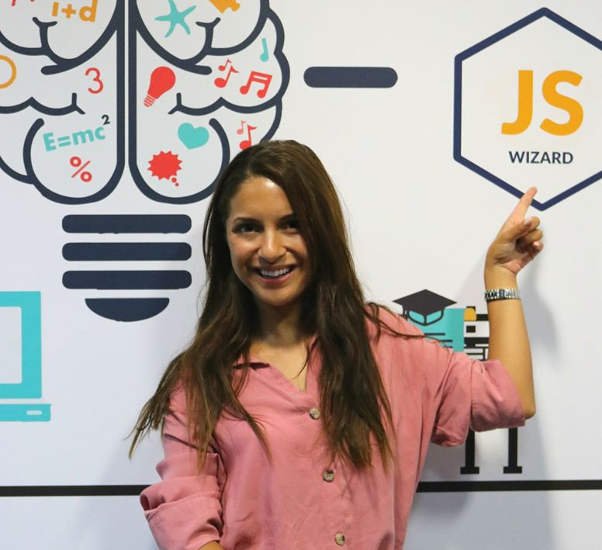
Antonia Atanasova
Front End Developer @ Devexperts & Technical Trainer @ SoftUni
Web Development/Design Freelancer
Host @ SoftUni Podcast: IT Talks
See more at antoniaat.com

Slide 12

Course Objectives
Course Details and Schedule

Slide 13
Why HTML & CSS?
HTML & CSS - standard for Web User Interface (UI)
Web-based applications are very popular
Runs on any device with a web browser
HTML5 is currently the #1 job trend based on the fastest growing keywords found in online job postings
HTML5 takes bigger chunk of the mobile application market
Every IT professional should know HTML & CSS

Slide 14

Practical Exam
Structure: 3 problems for 4 hours
Slice a screenshot to HTML + CSS
Make a responsive page
Create a simple landing page from screenshot (header + menu + sidebar + form elements + footer)

Slide 15
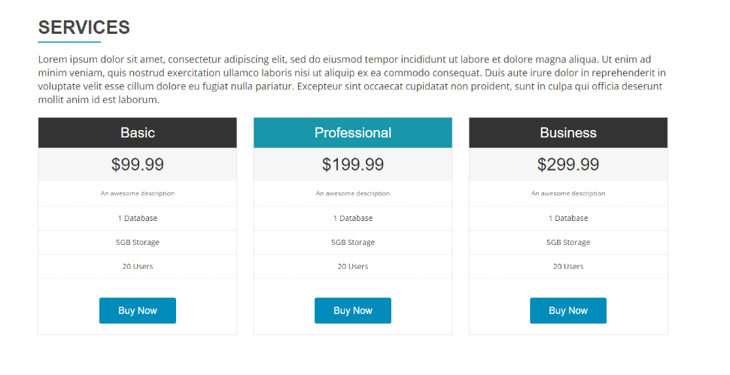
Exam: First Problem Demo
Slice a screenshot to HTML + CSS

Slide 16
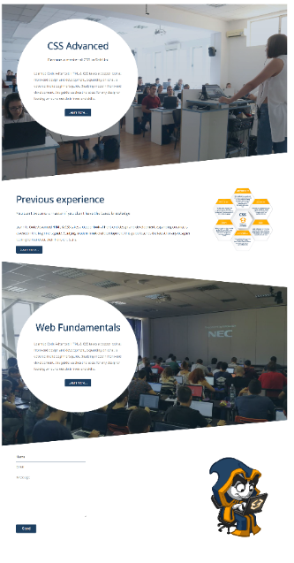

Exam: Second Problem Demo
Make a website responsive

Slide 17

Exam: Third Problem Demo
Create a simple web page from screenshot

Slide 18
Theoretical Exam
At least 15 questions for 30 minutes
Multiple-choice
English
Automated quiz system
Available online on the day of the practical exam
You can submit your answers just one time
18

Slide 19

Course Organization
Resources

Slide 20


SoftUni Certificate
Practical Exam 100%
Homework 5%
Evaluation

Slide 21
CPE Certificate
Practical Exam
Theoretical Exam
Evaluation
21

Slide 22
Homework Assignments
Doing your homework is very important!
HTML and CSS can only be learned through a lot of practice!
You should write code every day!
Each lesson is followed by a few exercises
Try to solve them in class
The rest are your homework
Homework assignments will be open for submissions from the start of the course to 1 day before the exam
Submission are accepted through: judge.softuni.bg

Slide 23
Website, Forum and FB Group
Official website:
Official discussion forum:
Official Facebook group:
https://softuni.bg/trainings/3359/html-and-css-may-2021
https://softuni.bg/forum/categories/671/Front-End-Development
https://www.facebook.com/groups/htmlandcssmay2021

Slide 24
Code Editors
You may try many HTML authoring tools
Recommended:
Visual Studio Code
Other notable editors:
WebStorm
Sublime Text / Atom / Brackets
24

Slide 25
Learn to Search in Internet & Find Solutions
The course assignments require to search in Internet
This is an important part of the learning process
Some exercises intentionally have no hints
Learn to find solutions!
Software development includes everyday searching and learning
No excuses, just learn to study!
Developers learn new technologies, tools, languages every day!

Slide 26
Questions?
Notes:
26

Slide 27
Trainings @ Software University (SoftUni)
Software University – High-Quality Education, Profession and Job for Software Developers
softuni.bg, about.softuni.bg
Software University Foundation
softuni.foundation
Software University @ Facebook
facebook.com/SoftwareUniversity
Software University Forums
forum.softuni.bg
27
Notes:
27

Slide 28

License
This course (slides, examples, demos, exercises, homework, documents, videos and other assets) is copyrighted content
Unauthorized copy, reproduction or use is illegal
© SoftUni – https://about.softuni.bg/
© Software University – https://softuni.bg
Notes:
28

